Slide 1
SMART CONTRACTS

Slide 3
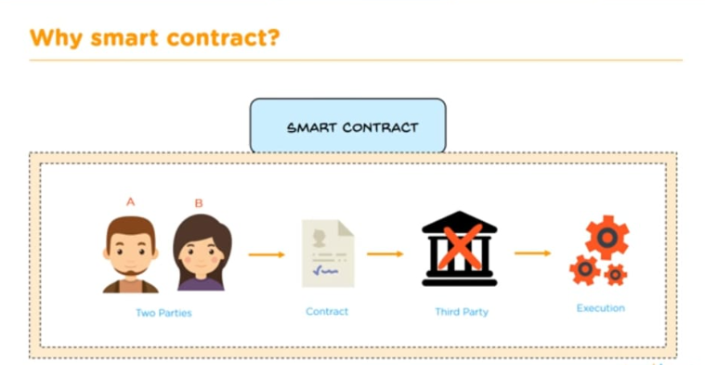

Slide 4
SMART CONTRACTS
Smart contracts are simply programs stored on a blockchain that run when predetermined Conditions are met. They typically are used to automate the execution of an agreement so that all participants can be immediately certain of the outcome, without any intermediary’s involvement or time loss. They can also automate a workflow, triggering the next action when conditions are met.

Slide 5
Benefits of smart contracts
Speed, efficiency and accuracy
Once a condition is met, the contract is executed immediately. Because smart contracts are digital and automated, there’s no paperwork to process and no time spent reconciling errors that often result from manually filling in documents.
2. Trust and transparency
Because there’s no third party involved, and because encrypted records of transactions are shared across participants, there’s no need to question whether information has been altered for personal benefit.
3. Security
Blockchain transaction records are encrypted, which makes them very hard to hack. Moreover, because each record is connected to the previous and subsequent records on a distributed ledger, hackers would have to alter the entire chain to change a single record.
4. Savings
Smart contracts remove the need for intermediaries to handle transactions and, by extension, their associated time delays and fees.

Slide 6
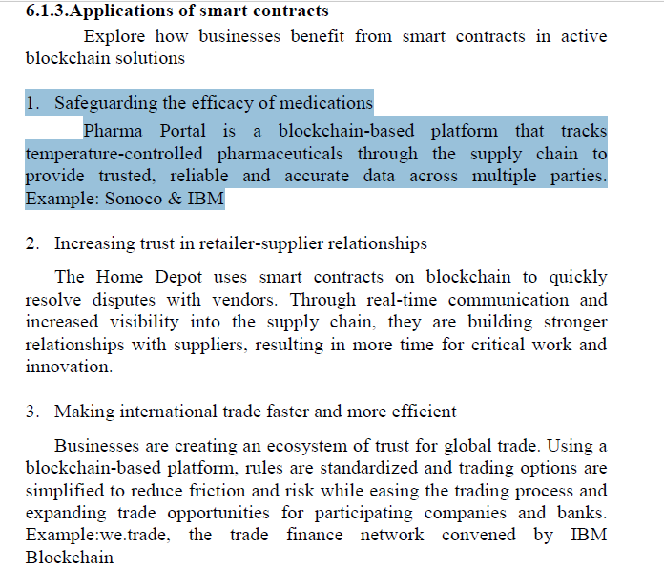

Slide 7
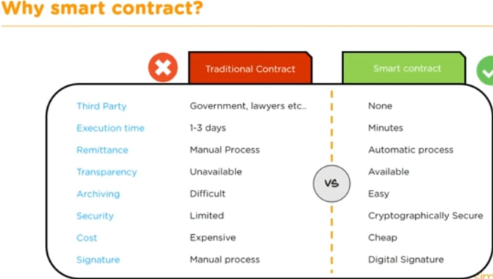

Slide 9
